Slide 1

1. Simplify the expression below.
2. Simplify the expression below.
A. C. B. D.
A. C. B. D.
3. Simplify the expression below.
4. Simplify the expression below.
A. C. B. D.
A. C. B. D.
5. Simplify the expression below.
6. Simplify the expression below.
A. C. B. D.
A. C. B. D.

Slide 2

7. Simplify the expression below.
8. Simplify the expression below.
A. C. B. D.
A. C. B. D.
9. Simplify the expression below.
10. Simplify the expression below.
A. C. B. D.
A. C. B. D.
11. Simplify the expression below.
12. Find the area of the triangle below.
A. C. B. D.
A. C. B. D.

Slide 3


13. Given the volume, V, of the rectangular prism below, find h, the height of the prism.
14. Find the perimeter of the rectangle below.
A. C. B. D.
A. C. B. D.
15. Solve the equation below.
16. Solve the equation below.
a =
k =
17. Solve the equation below.
18. Solve the equation below.
n =
x =

Slide 4

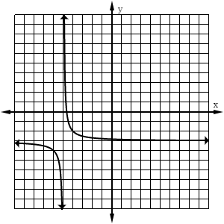
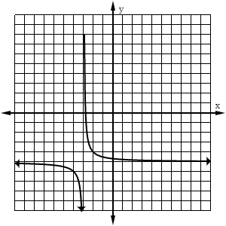
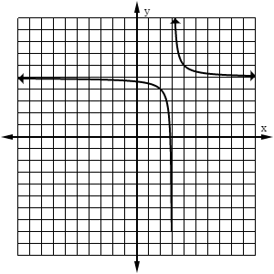
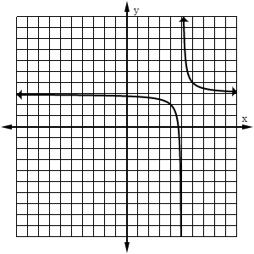
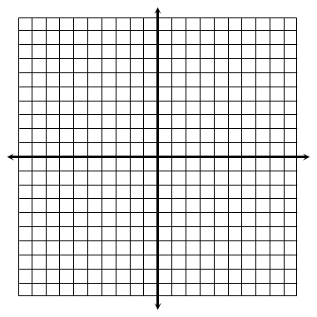
19. Which graph represents the function ?
A. B. C. D.
Use for questions 20-21: The parent function of a reciprocal function is translated two units left and four units down.
20. Which of the following represents the horizontal asymptote of the new function?
21. What is the domain of this function?
A. x = 2 B. x = -4 C. y = -2 D. y = -4
A. B. C. D.
Graph each function below and identify its key characteristics.
22.
x-int: ___________________________
VA: ___________________________
__ HA: ___________________________
Hole: ___________________________
Domain: ___________________________
Range: ___________________________
23.
x-int: ___________________________
VA: ___________________________
__ HA: ___________________________
Hole: ___________________________
Domain: ___________________________
Range: ___________________________

Slide 5

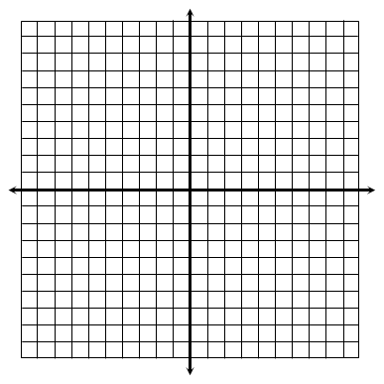

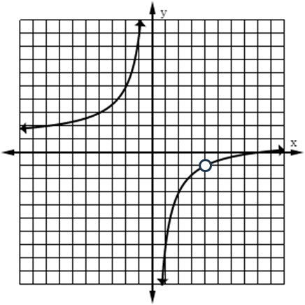
24.
x-int: ___________________________
VA: ___________________________
__ HA: ___________________________
Hole: ___________________________
Domain: ___________________________
Range: ___________________________
25. Which functions have a vertical asymptote at x = -2? Check all that apply.
26. Which statement accurately describes the horizontal asymptotes of the functions below?
A. The horizontal asymptote for f (x) is y = 0; The horizontal asymptote for g(x) is y = 1 and y = -1. B. The horizontal asymptote for f (x) is y = 1; The horizontal asymptote for g(x) is y = 0. C. The horizontal asymptotes for both functions is y = 1. D. The horizontal asymptotes for both functions is y = 0.
27. Which equation could represent the function graphed below?
A. B. C. D.

Slide 6

28. Which statement accurately describes the relationship between variables in the equation below?
A. “K varies jointly as v squared and m” B. “K is inversely proportional to v squared and directly proportional to m” C. “K is directly proportional to v squared and inversely proportional to m” D. “K varies jointly as v squared and is inversely proportional to m”
29. If p varies jointly as q and r, and p = 150 when q = 18 and r = 5, find q when p = 345 and r = 9.
q =
30. The time needed to paint a fence varies directly with the length of the fence and inversely with the number of painters. If it takes seven hours to paint 280 feet of fence with two painters, how long will it take four painters to paint 720 feet of fence?
BONUS: Solve the equation below.
x =

